Slide 1

Chapter 6
Delivery and Forwarding of
IP Packets
Copyright © The McGraw-Hill Companies, Inc. Permission required for reproduction or display.
Notes:
IP address 解决了计算机的地址命名问题，接下来需要解决数据包的传送问题

Slide 2
Architecture of the Internet
Information: IP packet
Node: router
Channel: physical network
→ Select the path
→ Transmit IP packets
R
R
R
R
R
R
Notes:
Internet中，PPP网络虽然存在，但是比例极小，更多是通过中间设备进行数据转发的，如早期的DCE DTE，发展到后来的路由器，特别是IP编址和协议将寻路问题独立分层

Slide 3
Delivery, Forwarding and Routing
Route 1
Source
Destination
Route 2
Delivery：交付
Supervising the handling of the packets by the underlying physical networks
对分组的物理发送
Forwarding：转发
Placing the packet in its route to its destination
查路由表（routing table）找到到达分组目的地的路径
Routing：路由选择
Creating and maintaining routing tables
找寻并维护到所有可能目的地的路径
Notes:
数据包在网络中传送时，设备的行为分为三类：交付，转发和路由选择

Slide 4
Discussion
路由表
标准术语：Routing table，路由选择表
不规范的术语：route table
Routing vs. Forwarding
Routing的狭义概念：生成、维护路由表的过程
Routing protocols，路由选择协议（路由协议）
Routing的广义概念：选路
选择到所有可能目的地的路径 —— 狭义的Routing
选择到特定分组目的地的路径 —— Forwarding
Route vs. Routing —— 均可简称为“路由”
Route：路径（path）
Routing：选择路径的过程
操作对象
Notes:
Routing有选路的动作指示，而route只是路径，所以严格来说时routing table 路由表，而不是route table路径表，但route是routing的前提

Slide 5
Discussion
IP分组传输环境
多个网络
多个路由器
IP通信 —— 无连接通信
多种网络都能满足的通信方式
允许多种选路策略（如：带宽、延时）
尽最大努力交付，best-effort delivery
→ 差异：通信能力、分组长度、延时
→ 独立选路
Notes:
IP协议基于分组交换，更适合internet，首先是多个异构网络共存，无连接的方式更简单，对单个数据包负责即可，每个数据包可以单独选路，每一跳的带宽，延时都可以灵活适应，并且面对混杂的网络形态，选择了best-effort delivery的原则，即end to end的原则，简单

Slide 6
OBJECTIVES:
To discuss the delivery of packets in the network layer and distinguish between direct and indirect delivery.
To discuss the forwarding of packets in the network layer and distinguish between destination-address–based forwarding and label-based forwarding.
To discuss different forwarding techniques, including next-hop, network-specific, host-specific, and default.
To discuss the contents of routing tables in classful and classless addressing and some algorithms used to search the tables.
To introduce MPLS technology and show how it can achieve label based forwarding.
To list the components of a router and explain the purpose of each component and their relations to other components.

Slide 7
Chapter Outline
6.1 Delivery
6.2 Forwarding
6.3 Structure of a Router

Slide 8
6-1 DELIVERY
The network layer supervises the handling of the packets by the underlying physical networks. We define this handling as the delivery of a packet.
The delivery of a packet to its final destination is accomplished using two different methods of delivery: direct and indirect.
Notes:
依赖网络以下层实现分组发送的行为，分组能够到达最终目的地，往往是由直接发送和间接发送组合接力实现的

Slide 9
Topics Discussed in the Section
Direct Delivery
Indirect Delivery

Slide 10
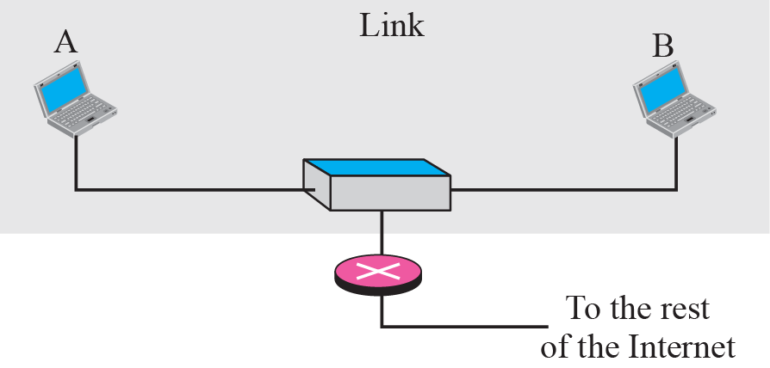
Figure 6.1 Direct delivery
The final destination of the packet is a host connected to the same physical network as the deliverer.
Notes:
Direct delivery occurs when the source and destination of the packet are located on the same physical network or if the delivery is between the last router and the destination host

Slide 11
Direct delivery
The sender can easily determine if the delivery is direct. It can extract the network address of the destination (using the mask) and compare this address with the addresses of the networks to which it is connected.
If a match is found, the delivery is direct.
Notes:
In direct delivery, the sender uses the destination IP address to find the destination physical address. The IP software then gives the destination IP address with the destination physical address to the data link layer for actual delivery. This process is called mapping the IP address to the physical address.

Slide 12
Figure 6.2 Indirect delivery
In an indirect delivery, the packet goes from router to router until it reaches the one connected to the same physical network as its final destination.
Notes:
the sender uses the destination IP address and a routing table to find the IP address of the next router to which the packet should be delivered

Slide 13
Direct vs. Indirect Delivery
Direct delivery（直接交付）
分组目的与分组的发送接口在同一IP网络中
Indirect delivery（间接交付）
分组目的与分组的发送接口在不同IP网络中
direct
delivery
indirect
delivery
direct
delivery
S
D1
D2
Net 1
Net 2
Notes:
这些route又被拆分为一段段的物理路径，所以交付行为分为两种，直接交付和间接交付

Slide 14
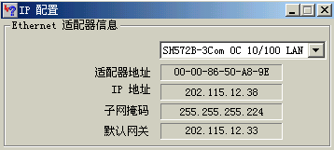
Indirect Delivery Configuration of the Host
命令：winipcfg
（ipconfig）
Windows使用TCP/IP与网外通信时使用的间接交付地址，一般设置为可与外网进行通信的路由器。

Slide 15
Discussion
一次交付过程
0或多个间接交付+1个直接交付（最后的交付）
分组:（源IP地址，目的IP地址）保持不变
帧:（源物理地址，目的物理地址）逐跳改变
A
11
12
21
22
B
Net 1
Net 2
Net 3
（IP_{A} , IP_{B}）
（Ph_{A} , Ph₁₁）
（IP_{A} , IP_{B}）
（Ph₁₂ , Ph₂₁）
（IP_{A} , IP_{B}）
（Ph₂₂ , Ph_{B}）

Slide 16
思考
下图所示的以太网中，哪几对主机间能进行IP通信？哪几对不能进行IP通信？为什么？
Solution
IP网内：直接交付 → 目的IP地址
IP网间：间接交付 → 下一跳IP地址（路由器）
能通信：A←→B ，C←→D
不能通信：IP网间（无路由器进行IP网间路由）
200.1.1.1/24
200.1.1.2/24
200.1.2.1/24
200.1.2.2/24
A
B
C
D

Slide 17
Chapter Outline
6.1 Delivery
6.2 Forwarding
6.3 Structure of a Router

Slide 18
6-2 FORWARDING
Forwarding means to place the packet in its route to its destination. Since the Internet today is made of a combination of links (networks), forwarding means to deliver the packet to the next hop (which can be the final destination or the intermediate connecting device). Although the IP protocol was originally designed as a connectionless protocol, today the tendency is to use IP as a connection-oriented protocol.

Slide 19
Topics Discussed in the Section
Forwarding Based on Destination Address
Forwarding Based on Label
Notes:
When IP is used as a connectionless protocol, forwarding is based on the destination address of the IP datagram; when the IP is used as a connection-oriented protocol, forwarding is based on the label attached to an IP datagram

Slide 20
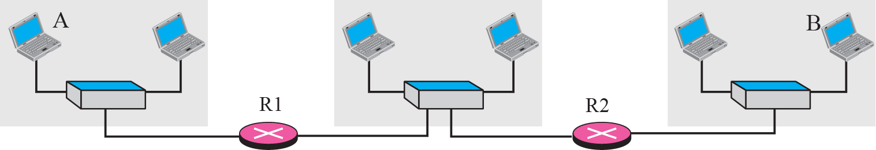
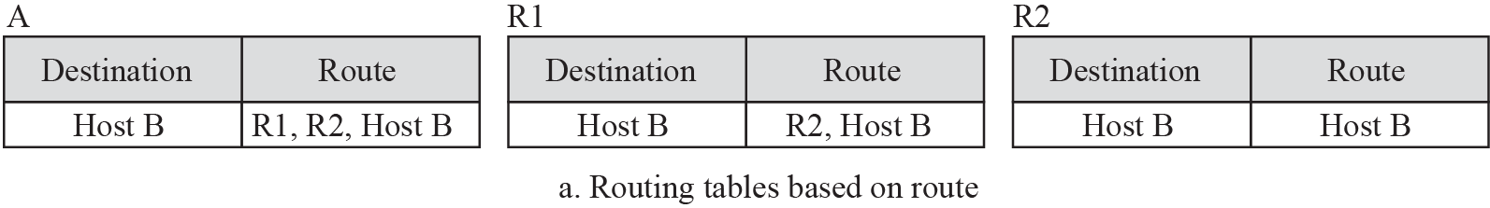
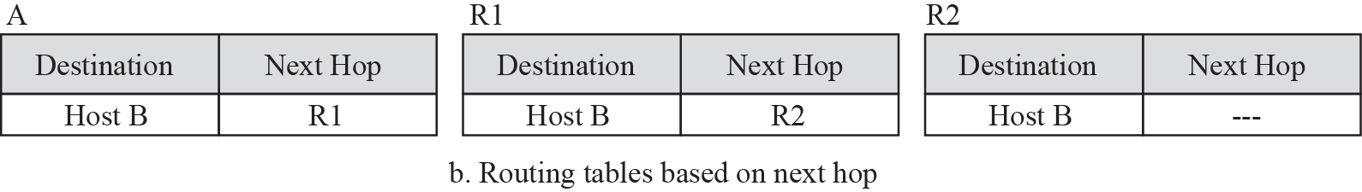
Figure 6.3 Next-hop method
Notes:
In this technique, the routing table holds only the address of the next hop instead of information about the complete route.

Slide 21
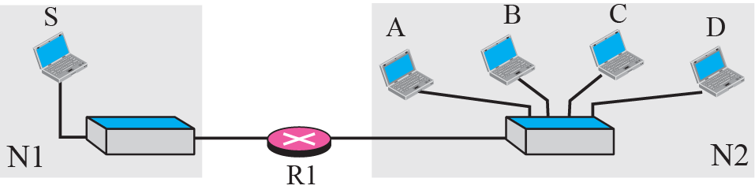
Figure 6.4 Network-specific method
Notes:
Here, instead of having an entry for every destination host connected to the same physical network, we have only one entry that defines the address of the destination network.For example, if 1000 hosts are attached to the same network, only one entry exists in the routing table instead of 1000

Slide 22
Discussion
Network-specific routing
路由表的大小只与网络的个数有关，与每个网络的大小（包含的主机数多少）无关
Next-hop routing
路由器独立选路，从Net 1到Net 2的路径可能与从Net 2到Net 1的路径不是同一条
只有最后一个路由器才知道目的主机是否存在
Net 1→A→B→C→Net 2
A
B
C
Net 1
Net 2
D
E
Net 1←A←D←E←Net 2
Notes:
对路由器来说，涉及到交付delivery，其语法的2个要素设计很关键，1是目的地址，取网络号，那么路由表大小只与网络个数有关
2是后续路径，取下一跳地址，则每个数据包在每一段上都是独立寻路，只有到达最后才知道路由器是否真的存在

Slide 23
Figure 6.5 Host-specific routing
If the administrator wants all packets arriving for host B delivered to router R3 instead of R1, one single entry in the routing table of host A can explicitly define the route.

Slide 24
Host-specific routing
A route for a specific host
Feature
Host mask: all 1s
Function
Route check
Security
Management
Dst. Network
Next-hop Address
IP
Mask
I₁
Mask₁
－
I_{B}
/32
I₁₁
I₃
Mask₃
I₁₂
I_{A}
Net 1
I₁, Mask₁
Host B
I₁₂
I₁₁
Net 3
I₂₁
I₃₂
I_{B}
Net 2
I₂, Mask₂
Net 3
I₃, Mask₃
I₂₂
I₃₁
Notes:
也可以人为设置一些面向主机的特殊路由，掩码取32位，这与特定网络的方法正好相反，但可以牺牲效率以换取其它收益，如安全性，检查路由或提供安全措施时，例如图中的设置，就会使到达IB的数据包都经过右边的路由器

Slide 25
Default routing
Use a default route if no entry for destination network in the routing table
Feature
Destination network address = 0.0.0.0
Destination network mask = 0.0.0.0
Function
Make the routing table smaller
A lot of routing information is hidden
Notes:
默认表项

Slide 26
Figure 6.6 Default routing
Notes:
So instead of listing all networks in the entire Internet, host A can just have one entry called the default (normally defined as network address 0.0.0.0).

Slide 27
Routing Loop
主机和路由器的默认路由设置
Dst. Network
Next-hop Address
Dst. Network
Next-hop Address
IP
Mask
IP
Mask
I₁
Mask₂
－
I₂
Mask₂
－
I₂
Mask₃
－
I₃
Mask₃
－
0.0.0.0
/0
I₂₂
0.0.0.0
/0
I₂₁
I₁₁
I₃₁
Net 1
I₁, Mask₁
Net 3
I₃, Mask₃
Net4
I₂₁
I₂₂
Net 2
I₂, Mask₂
Routing loop
Net 4
I₄, Mask₄
Notes:
除了指定的目的地址外，其它地址都按默认地址对待

Slide 28
Forwarding
Idea → 减小并简化路由表
使用尽可能少的信息实现转发
Information of the routing table
Destination：Network vs. Host
How to get：Next hop vs. All hops
✗
→ Network-specific routing
节约路由表的存储空间，提高查表效率
✗
→ Next-hop routing
简化路由表，每个路由器独立选路
Notes:
对路由器来说，涉及到交付delivery，其语法的2个要素设计很关键，1是目的地址，2是后续路径

Slide 29
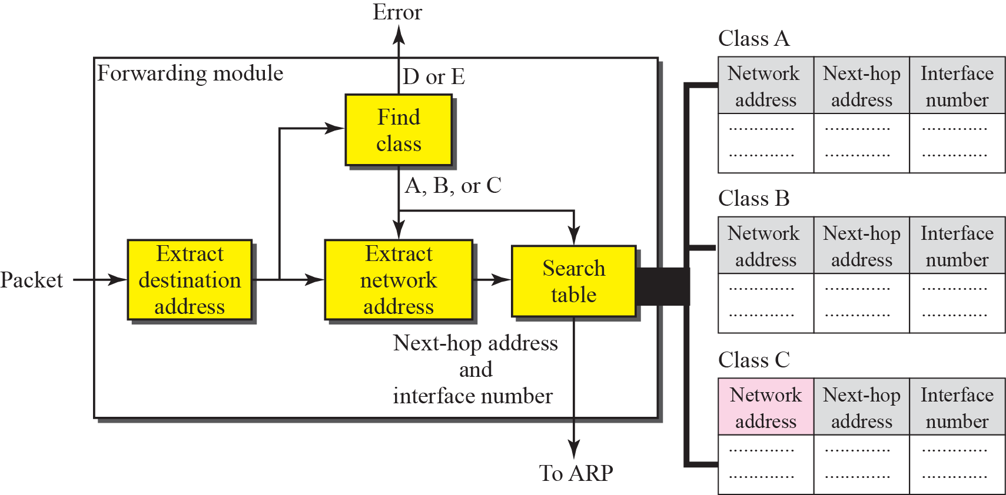
Figure 6.7 Simplified forwarding module in classful address without subnetting
Notes:
As we mentioned in the previous chapter, classful addressing has several disadvantages. However, the existence of a default mask in a classful address makes the forwarding process simple.分类地址有些缺点，规定的网络大小，存在资源浪费，但我们可以利用掩码，相对要简单一点
图中，没有子网的地址类型，我们按照ABC分类的地址范围进行地址解析，分别处理，如果支持多播，还有增加一张D类地址的表，3张表使得搜索效率更高

Slide 30
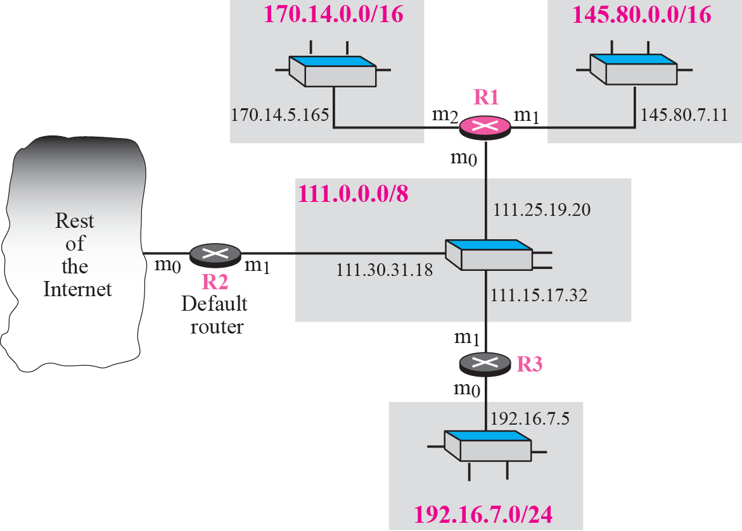
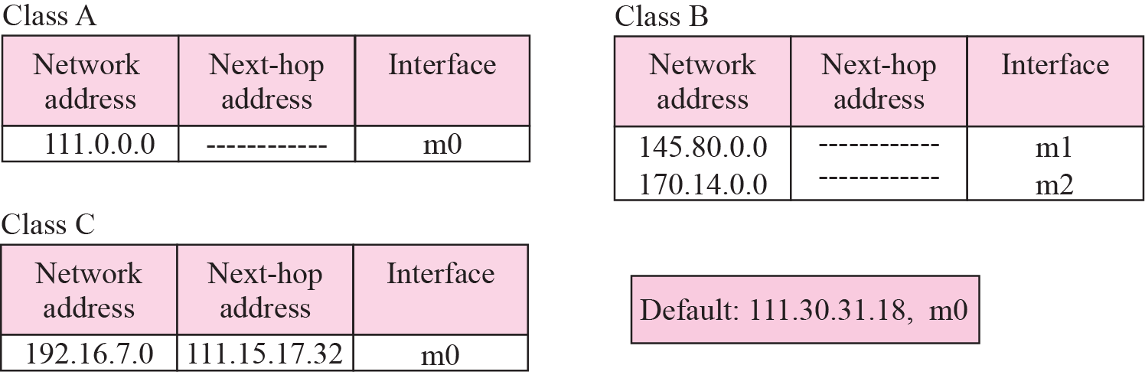
Figure 6.8 ~6.9 Configuration for routing, Example 6.1

Slide 31
Example 6.1
Figure 6.8 shows an imaginary part of the Internet. Show the routing tables for router R1.
Solution
Figure 6.9 shows the three tables used by router R1. Note that some entries in the next-hop address column are empty because in these cases, the destination is in the same network to which the router is connected (direct delivery). In these cases, the next-hop address used by ARP is simply the destination address of the packet as we will see in Chapter 8.
Notes:
some entries in the next-hop address column are empty because in these cases, the destination is in the same network to which the router is connected (direct delivery)

Slide 32
Example 6.2
Router R1 in Figure 6.8 receives a packet with destination address 192.16.7.14. Show how the packet is forwarded.

Slide 33
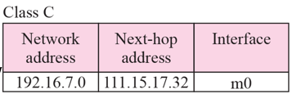
Example 6.2
Router R1 in Figure 6.8 receives a packet with destination address 192.16.7.14. Show how the packet is forwarded.
Solution
The destination address is
11000000 00010000 000001110 0001110. A copy of the address is shifted 28 bits to the right. The result is
00000000 00000000 00000000 00001100 or 12.
The destination network is class C. The network address is extracted by masking off the leftmost 24 bits of the destination address; the result is 192.16.7.0. The table for Class C is searched. The network address is found in the first row. The next-hop address 111.15.17.32. and the interface m0 are passed to ARP (see Chapter 8).

Slide 34
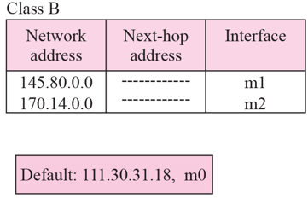
Example 6.3
Router R1 in Figure 6.8 receives a packet with destination address 167.24.160.5. Show how the packet is forwarded.
Solution
The destination address in binary is
10100111 00011000 10100000 00000101.
A copy of the address is shifted 28 bits to the right. The result is
00000000 00000000 00000000 00001010 or 10.
The class is B. The network address can be found by masking off 16 bits of the destination address, the result is 167.24.0.0. The table for Class B is searched. No matching network address is found. The packet needs to be forwarded to the default router (the network is somewhere else in the Internet). The next-hop address 111.30.31.18 and the interface number m0 are passed to ARP.

Slide 35
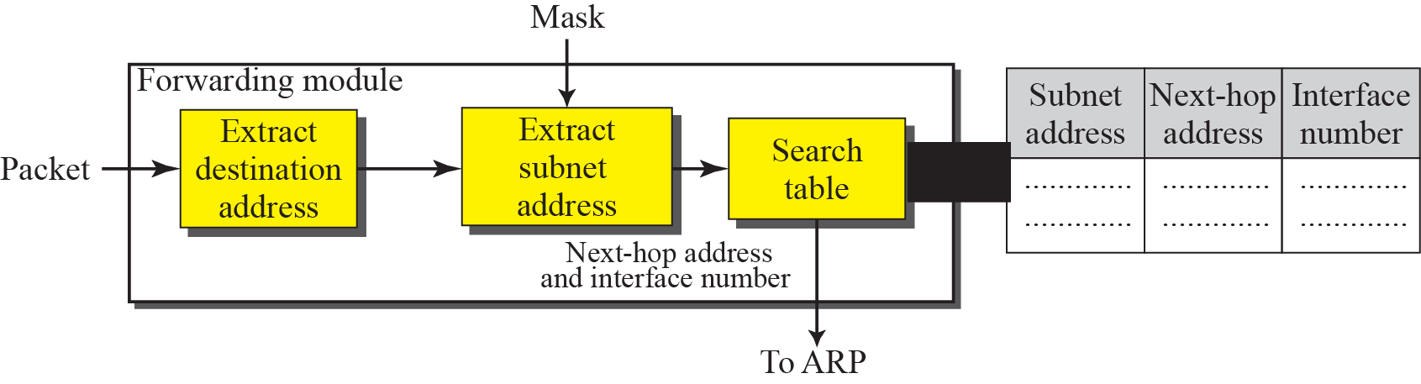
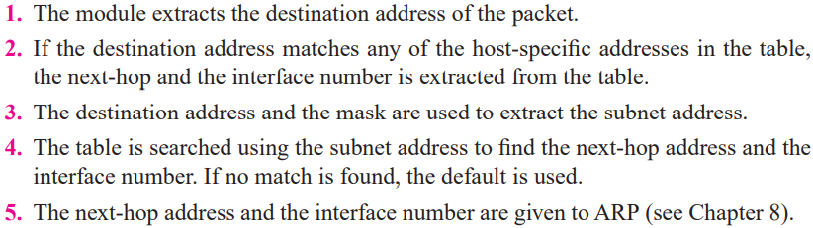
Figure 6.10 Simplified forwarding module in classful address with subnetting
The routers that handle subnetting are either at the border of the organization site or inside the site boundary

Slide 36
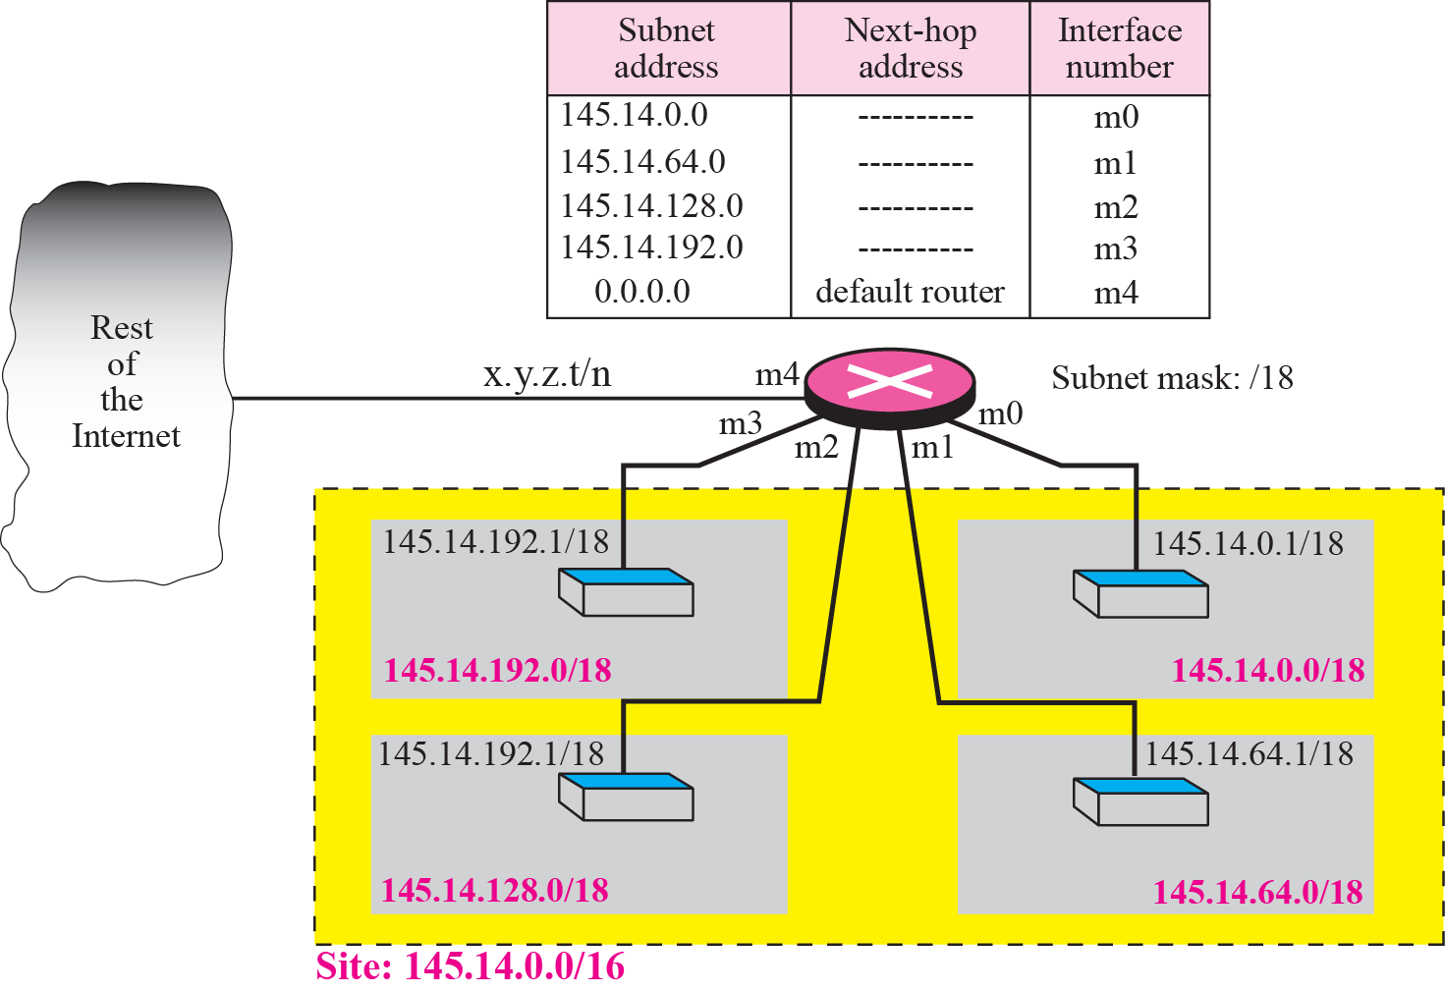
Example 6.4
Figure 6.11 shows a router connected to four subnets. Note several points.
First, the site address is 145.14.0.0/16 (a class B address). Every packet with destination address in the range 145.14.0.0 to 145.14.255.255 is delivered to the interface m4 and distributed to the final destination subnet by the router.

Slide 37
Example 6.4
Figure 6.11 shows a router connected to four subnets. Note several points.
Second, we have used the address x.y.z.t/n for the interface m4 because we do not know to which network this router is connected.

Slide 38
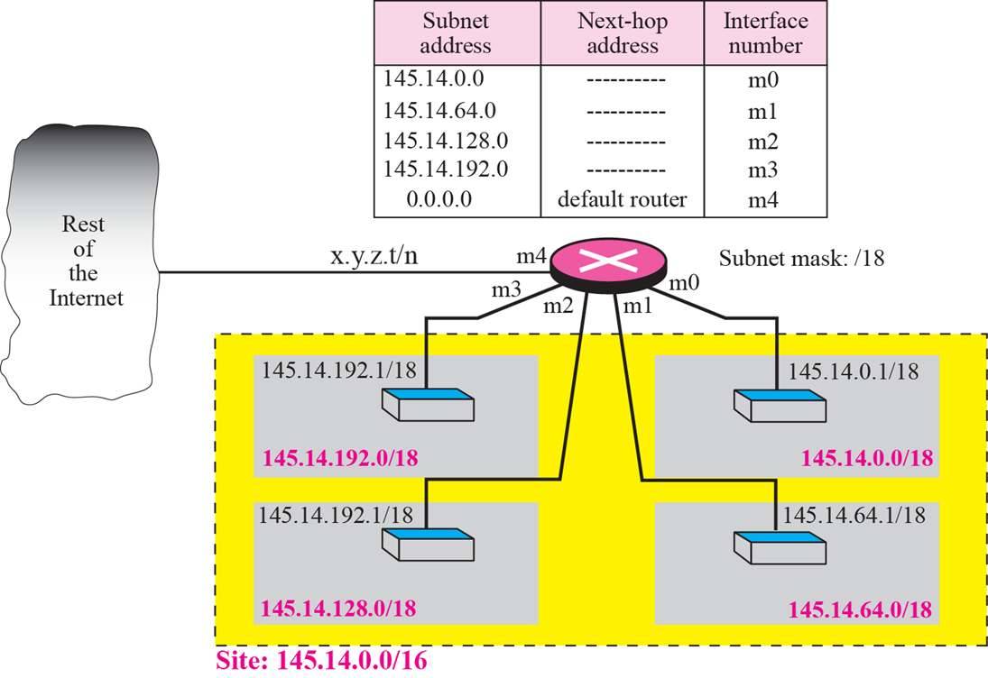
Example 6.4
Figure 6.11 shows a router connected to four subnets. Note several points.
Third, the table has a default entry for packets that are to be sent out of the site. The router is configured to apply the subnet mask /18 to any destination address.

Slide 39
Example 6.5
The router in Figure 6.11 receives a packet with destination address 145.14.32.78. Show how the packet is forwarded. Solution
The mask is /18. After applying the mask, the subnet address is 145.14.0.0. The packet is delivered to ARP (see Chapter 8) with the next-hop address 145.14.32.78 and the outgoing interface m0.

Slide 40
Example 6.6
A host in network 145.14.0.0 in Figure 6.11 has a packet to send to the host with address 7.22.67.91. Show how the packet is routed. Solution
The router receives the packet and applies the mask (/18). The network address is 7.22.64.0. The table is searched and the address is not found. The router uses the address of the default router (not shown in figure) and sends the packet to that router.

Slide 41

Note
In classful addressing we can have a routing table with three columns;
in classless addressing,
we need at least four columns.

Slide 42
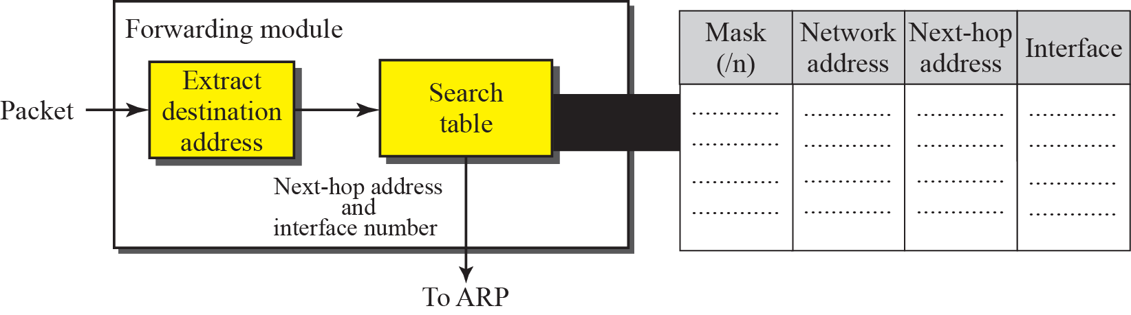
Figure 6.12 Simplified forwarding module in classless address

Slide 43
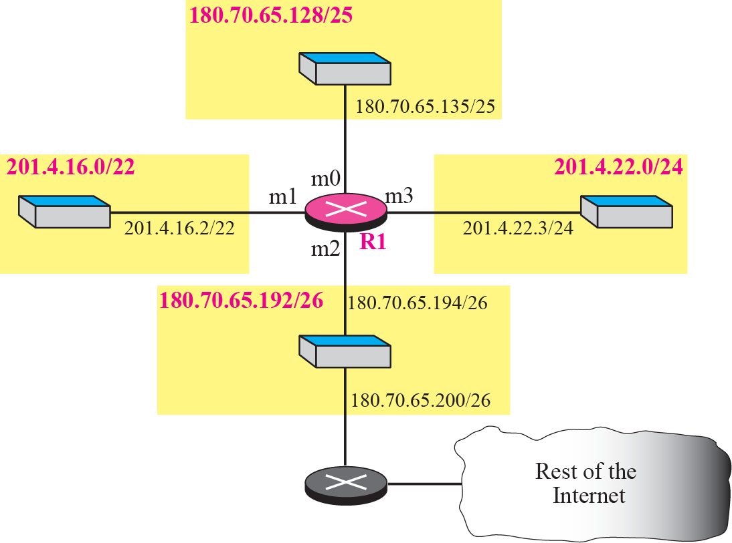
Example 6.7
Make a routing table for router R1 using the configuration in Figure 6.13.

Slide 44
Figure 6.13 Configuration for Example 6.7

Slide 45
Policy:
Direct route
Host-specific route
Network-specific route
Default route
最长匹配（longest match）

Slide 46
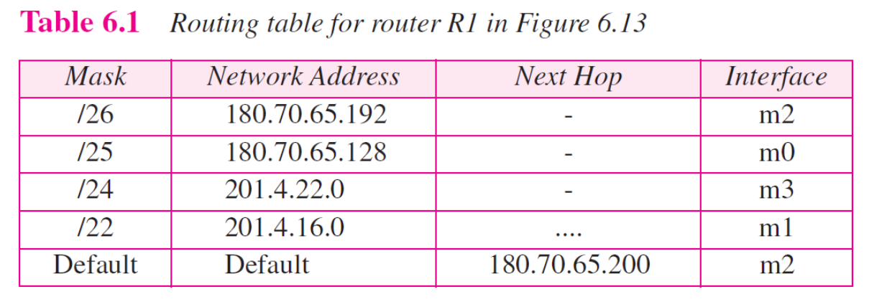
Example 6.8
Show the forwarding process if a packet arrives at R1 in Figure 6.13 with the destination address 180.70.65.140. Solution
The router performs the following steps:
1. The first mask (/26) is applied to the destination address. The result is 180.70.65.128, which does not match the corresponding network address.

Slide 47
Example 6.8
Show the forwarding process if a packet arrives at R1 in Figure 6.13 with the destination address 180.70.65.140. Solution
2. The second mask (/25) is applied to the destination address. The result is 180.70.65.128, which matches the corresponding network address. The next-hop address (the destination address of the packet in this case) and the interface number m0 are passed to ARP (see Chapter 8) for further processing.

Slide 48
Example 6.9
Show the forwarding process if a packet arrives at R1 in Figure 6.13 with the destination address 201.4.22.35. Solution
The router performs the following steps:
1. The first mask (/26) is applied to the destination address. The result is 201.4.22.0, which does not match the corresponding network address (row 1).

Slide 49
Example 6.9
Show the forwarding process if a packet arrives at R1 in Figure 6.13 with the destination address 201.4.22.35. Solution
2. The second mask (/25) is applied to the destination address. The result is 201.4.22.0, which does not match the corresponding network address (row 2).

Slide 50
Example 6.9
Show the forwarding process if a packet arrives at R1 in Figure 6.13 with the destination address 201.4.22.35. Solution
3. The third mask (/24) is applied to the destination address. The result is 201.4.22.0, which matches the corresponding network address.

Slide 51
Example 6.10
Show the forwarding process if a packet arrives at R1 in Figure 6.13 with the destination address 18.24.32.78. Solution
This time all masks are applied to the destination address, but no matching network address is found. When it reaches the end of the table, the module gives the next-hop address 180.70.65.200 and interface number m2 to ARP (see Chapter 8). This is probably an outgoing package that needs to be sent, via the default router, to someplace else in the Internet.

Slide 52
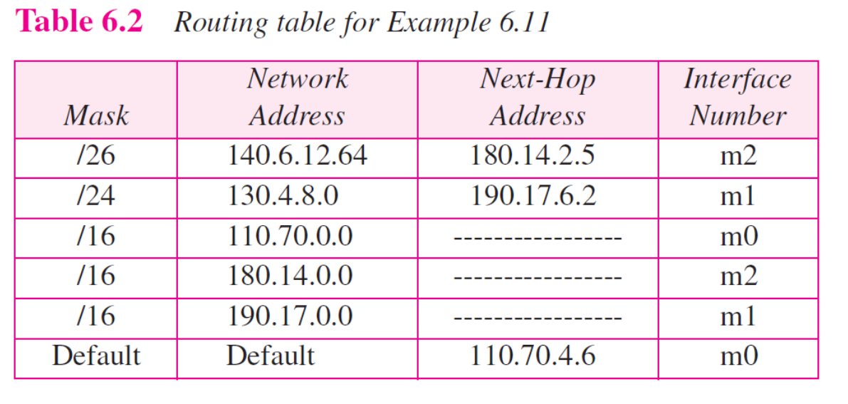
Example 6.11
Now let us give a different type of example. Can we find the configuration of a router if we know only its routing table? The routing table for router R1 is given in Table 6.2. Can we draw its topology?

Slide 53
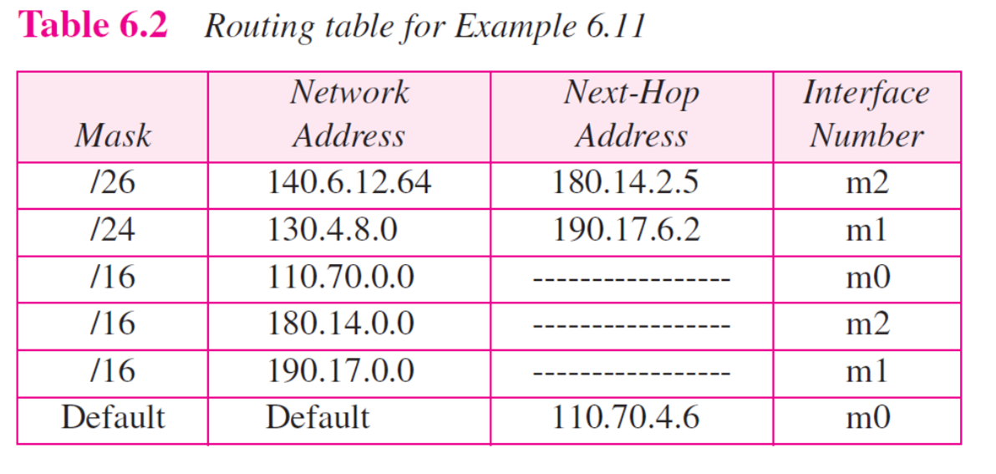
Example 6.11
Solution
We know some facts but we don’t have all for a definite topology. We know that router R1 has three interfaces: m0, m1, and m2. We know that there are three networks directly connected to router R1. We know that there are two networks indirectly connected to R1. There must be at least three other routers involved (see next-hop column). We do not know if network 140.6.12.64 is connected to router R3 directly or through a point-to-point network (WAN) and another router.

Slide 54
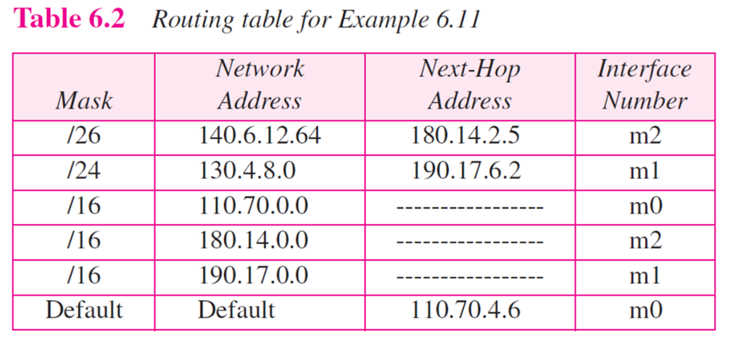
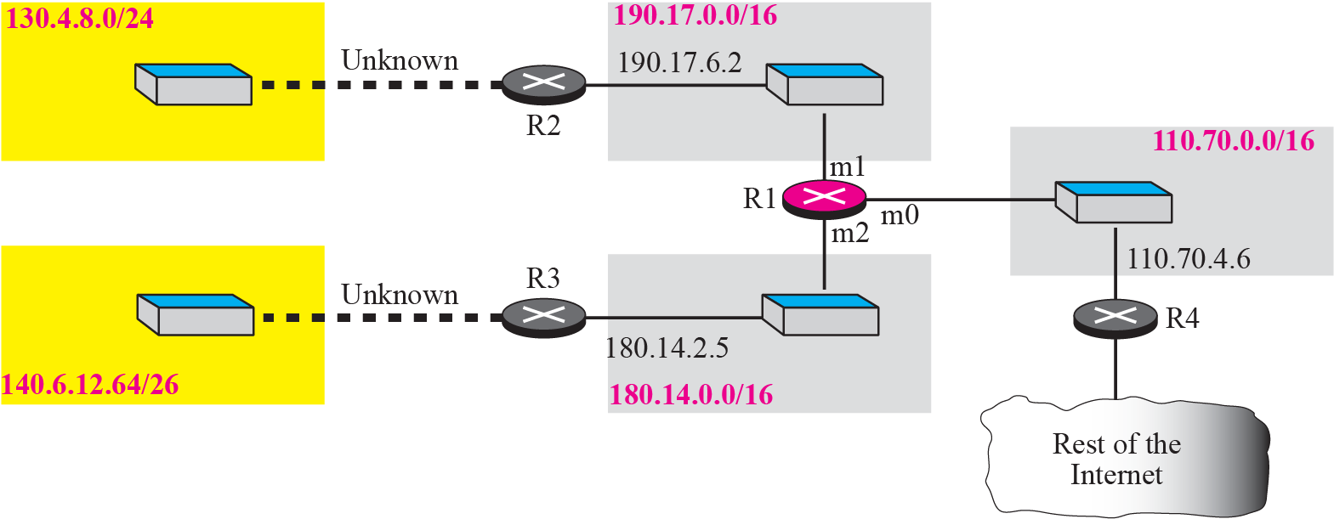
Figure 6.14 Guessed topology for Example 6.11

Slide 55
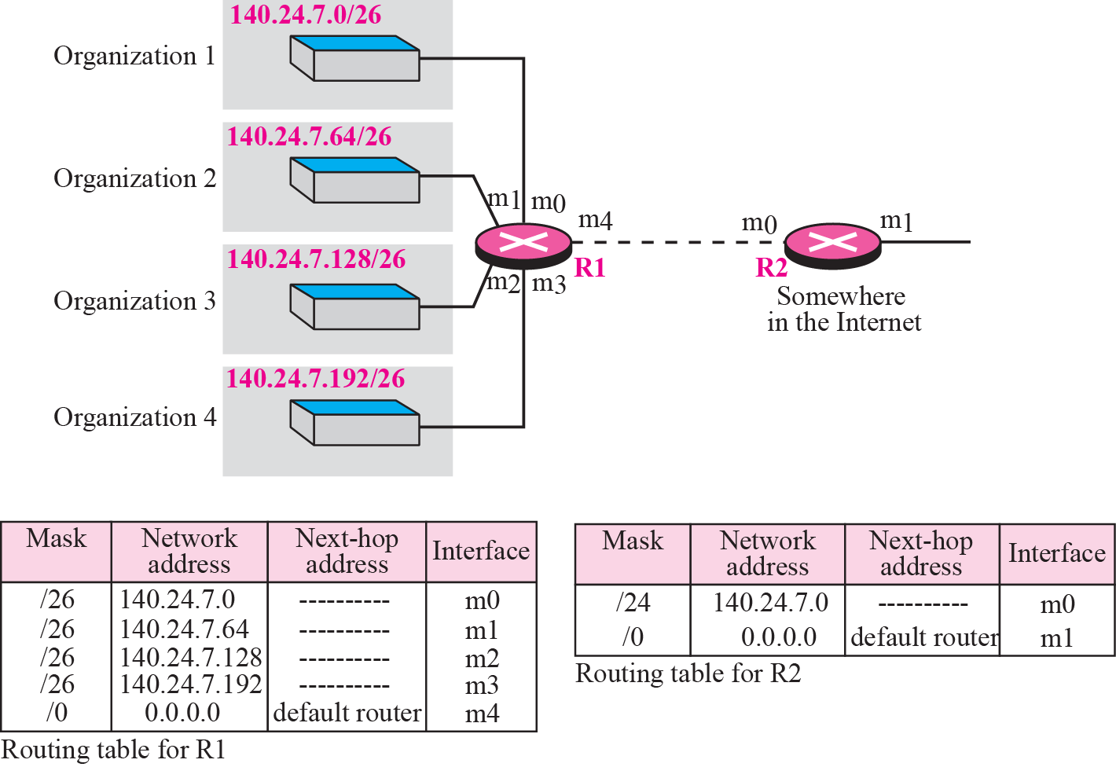
Figure 6.15 Address aggregation
Notes:
地址聚合

Slide 56
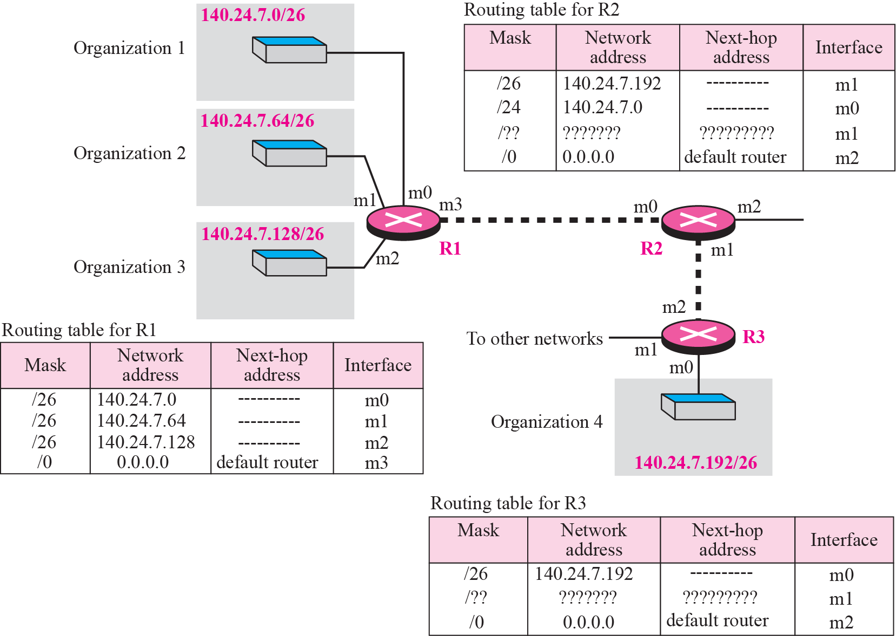
Figure 6.16 Longest mask matching
The routing table is sorted from the longest mask to the shortest mask.

Slide 57
Figure 6.16 Longest mask matching
140.24.7.200
Notes:
Suppose a packet arrives for organization 4 with destination address 140.24.7.200. The first mask at router R2 is applied, which gives the network address 140.24.7.192. The packet is routed correctly from interface m1 and reaches organization 4. If, however, the routing table was not stored with the longest prefix first, applying the /24 mask would result in the incorrect routing of the packet to router R1.

Slide 58
聚合应用
合理的IP地址规划
有效减少关键路由器选路表项，充分发挥路由器的转发性能
隐藏网络结构
自主管理网络边界使用路由器（即R2）与外界相连，在不改变原有IP地址范围的条件下，网络内部任意划分子网、改变拓扑结构等，都不会影响外部的路由器（即R1）选路表项。
自主管理网络
R1
R2

Slide 59
Hierarchical routing
The Internet today has a sense of hierarchy. We said that the Internet is divided into backbone, regional and local ISPs. If the routing table has a sense of hierarchy like the Internet architecture, the routing table can decrease in size.
Let us take the case of a local ISP. A local ISP can be assigned a single, but large, block of addresses with a certain prefix length. If the block assigned to the local ISP starts with a.b.c.d/n, the ISP can create blocks starting with e.f.g.h/m, where m may vary for each customer and is greater than n.

Slide 60
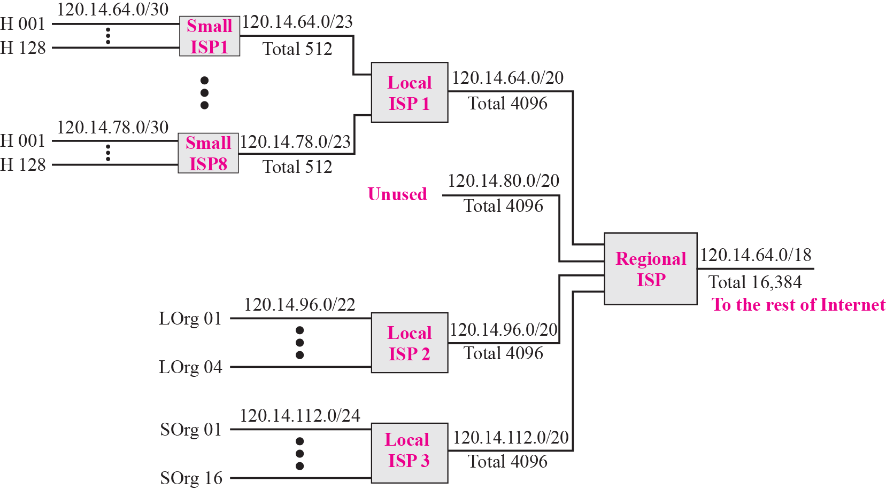
Example 6.12
A regional ISP is granted 16,384 addresses starting from 120.14.64.0. The regional ISP has decided to divide this block into 4 subblocks, each with 4096 addresses. Three of these subblocks are assigned to three local ISPs, the second subblock is reserved for future use. Note that the mask for each block is /20 because the original block with mask /18 is divided into 4 blocks.

Slide 61
Routing Table Search Algorithms
Searching in Classful Addressing
In classful addressing, the routing table is organized as a list. However, to make searching more efficient, the routing table can be divided into three tables (sometimes called buckets), one for each class.
Searching in Classless Addressing
In classless addressing, there is no network
information in the destination address. The simplest, but not the most efficient, search method is called the longest prefix match (as we discussed before).

Slide 62
Example 6.13
Figure 6.18 shows a simple example of searching in a routing table using the longest match algorithm. Although there are some more efficient algorithms today, the principle is the same.
When the forwarding algorithm gets the destination address of the packet, it needs to delve into the mask column. For each entry, it needs to apply the mask to find the destination network address.
It then needs to check the network addresses in the table until it finds the match.
The router then extracts the next hop address and the interface number to be delivered to the ARP protocol for delivery of the packet to the next hop.

Slide 63
Figure 6.18 Example 6.13: Forwarding based on destination address

Slide 64
Discussion：P2P Network
《TCP/IP协议族》第3版第120页例11：
“点到点网络通常在路由表中没有表项，因为没有主机连接到它们” —— 不准确
IP路由表
到所有可能的IP网络的路径信息
P2P网络
被指派了IP地址
—— 是IP网络，应在路由表中
采用第4章中的unnumbered P2P line编址方案
—— 不是IP网络，不在路由表中

Slide 65
Topics Discussed in the Section
Forwarding Based on Destination Address
Forwarding Based on Label
Notes:
When IP is used as a connectionless protocol, forwarding is based on the destination address of the IP datagram; when the IP is used as a connection-oriented protocol, forwarding is based on the label attached to an IP datagram

Slide 66
Connection-oriented vs. Connectionless Services
Service（服务）
Network application：业务
OSI/RM：下层为上层提供的一组操作
This chapter（TCP/IP）：通信协议
 | 面向连接 | 无连接
通信过程 | 建立连接→交付分组→终止连接 | 交付分组
路由选择 | 仅在建立连接时选路 | 每个分组独立选路
传输路径 | 相同 | 可以不同
Notes:
每条route都是一个逻辑路径，每个route的生存期是多久？这与网络底层的交换原理有关，就是前面介绍的电路交换和分组交换，面向连接的和无连接的

Slide 67
Forwarding Based on Label
In 1980s, an effort started to somehow change IP to behave like a connection-oriented
protocol in which the routing is replaced by switching.
In a connectionless network (datagram approach), a router forwards a packet based on the destination address in the header of packet.
On the other hand, in a connection-oriented network (virtual-circuit approach), a switch forwards a packet based on the label attached to a packet. .

Slide 68
Figure 6.19 Example 6.14: Forwarding based on label
Figure 6.19 shows a simple example of using a label to access a switching table. Since the labels are used as the index to the table, finding the information in the table is immediate.
Notes:
interface and
label address interface and
label address 0012

Slide 69

Figure 6.20 MPLS header added to an IP packet
During the 1980s, several vendors created routers that implement switching technology. Later IETF approved a standard that is called Multi-Protocol Label Switching.
In this standard, some conventional routers in the Internet can be replaced by MPLS routers that can behave like a router and a switch.
Notes:
the first thing that is needed is to add a field to the packet that carry the label

Slide 70
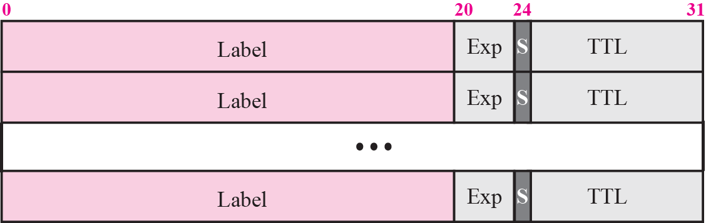
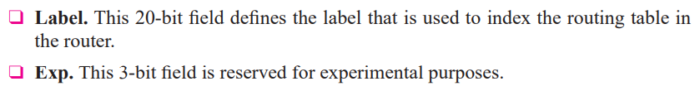
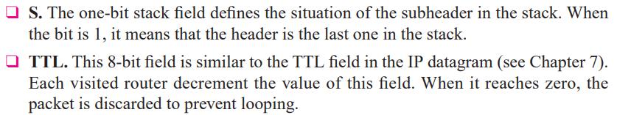
Figure 6.21 MPLS header made of stack of labels
Notes:
The MPLS header is actually a stack of subheaders that is used for multilevel hierarchical switching

Slide 71
Chapter Outline
6.1 Delivery
6.2 Forwarding
6.3 Structure of a Router

Slide 72
6-3 STRUCTURE OF A ROUTER
In our discussion of forwarding and routing, we represented a router as a black box that accepts incoming packets from one of the input ports (interfaces), uses a routing table to find the output port from which the packet departs, and sends the packet from this output port.
In this section we open the black box and look inside. However, our discussion won’t be very detailed; entire books have been written about routers.
Notes:
We just give an overview to the reader.

Slide 73
Topics Discussed in the Section
Components

Slide 74
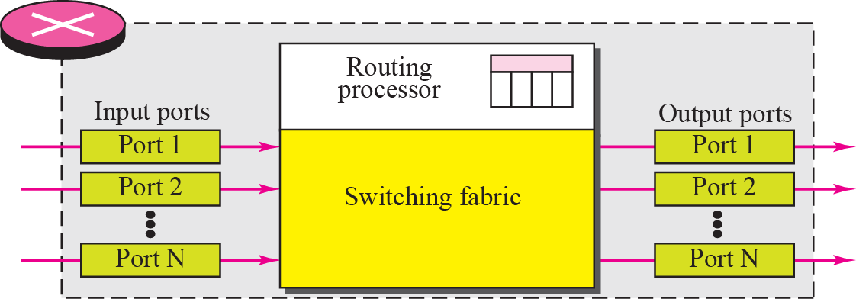
Figure 6.22 Router components

Slide 75
Routing Processor, Switching Fabric
Routing processor，路由选择处理器
Lookup routing table → forwarding
Create and maintain routing table → routing
Switching fabric，交换结构
Moving the packet from the input queue to the output queue
影响性能：输入/输出队列大小、分组交付时延
Structure
Bus，总线
Matrix，矩阵

Slide 76
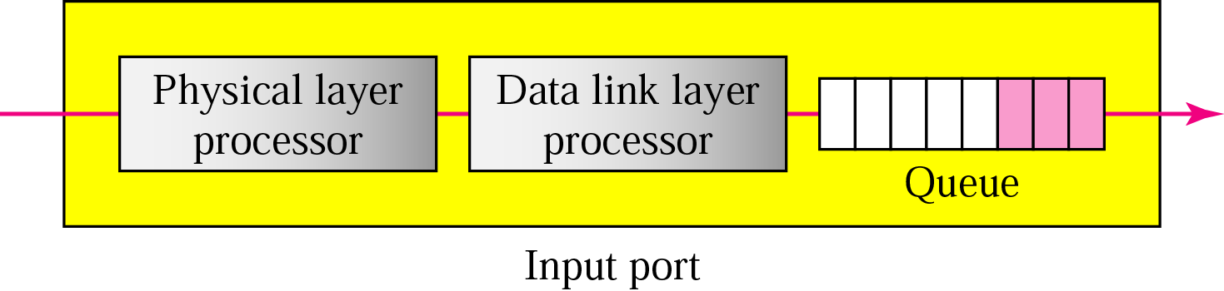
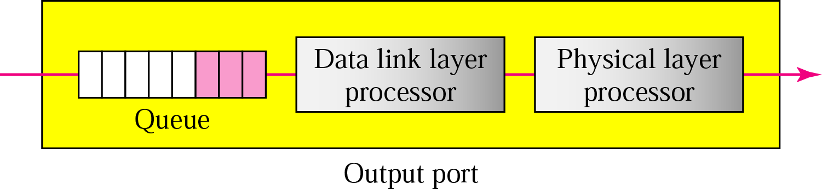
Input Port, Output Port
Input port
Output port
Notes:
The bits are constructed from the received signal. The packet is decapsulated from the frame. Errors are detected and corrected. The packet is ready to be forwarded by the network layer.

Slide 77
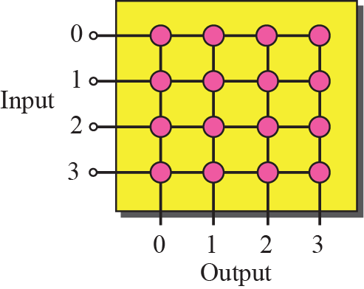
Figure 6.25 Crossbar switch
Notes:
交叉开关

Slide 78
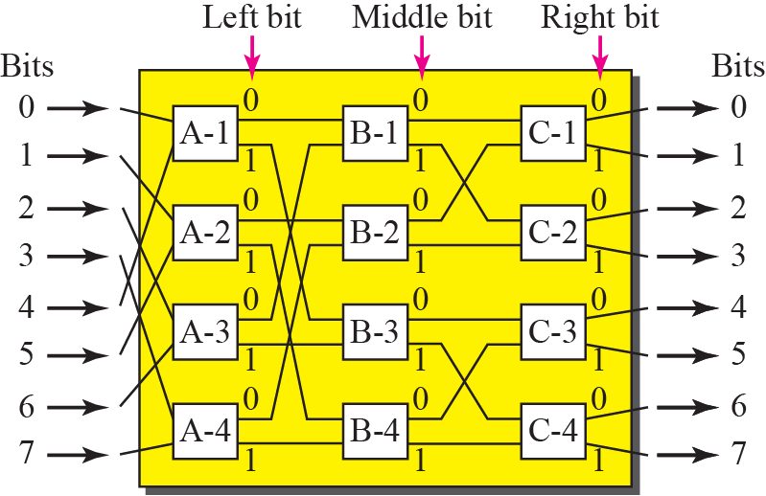
Figure 6.26 A banyan switch
Notes:
Batcher榕树接线器

Slide 79
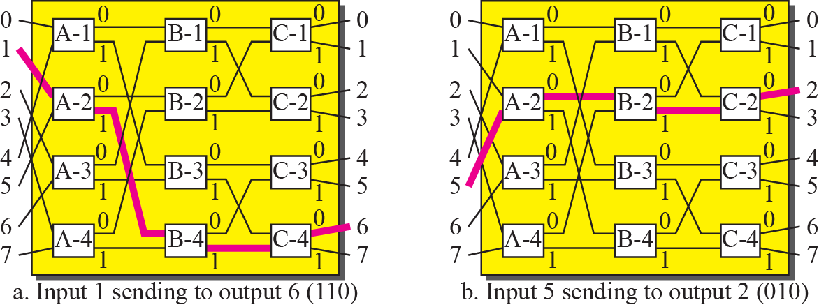
Figure 6.27 Examples of routing in a banyan switch

Slide 80
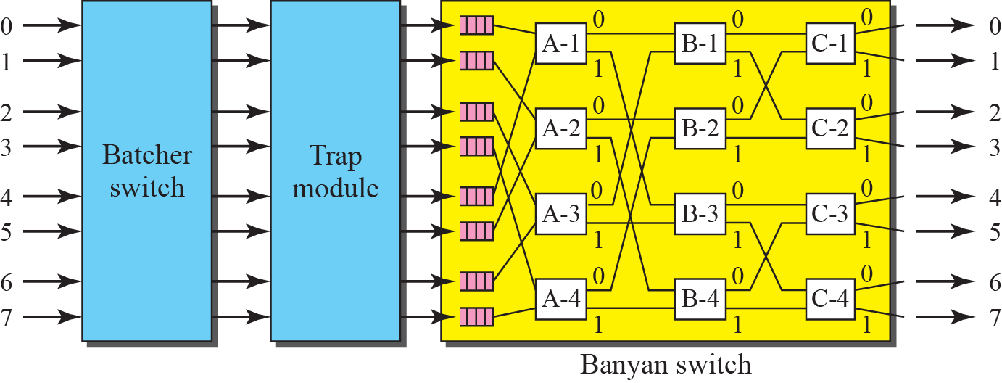
Figure 6.28 Batcher-banyan switch
Notes:
Normally, another hardware module called a trap is added between the Batcher switch and the banyan switch. The trap module prevents duplicate packets (packets with the same output destination) from passing to the banyan switch simultaneously.

Slide 81
Chapter Outline
6.1 Delivery
6.2 Forwarding
6.3 Structure of a Router

Slide 82
Thanks

